Slide 1


FITNESS HERE (E-Commerce) - 2K22

Slide 2

FITNESS HERE
E-Commerce

Slide 3
E-Commerce?
E-Commerce is the business of buying and selling goods and services over the internet. Ecommerce customers can make purchases from their computers as well as other touchpoints including smartphones, smartwatches.

Slide 4
Reason Behind FITNESS HERE
The original meaning of the design was to suggest “we're happy to deliver anything, anywhere and emphasizing that We offers anything, that customers may be looking to buy online.

Slide 5

FITNESS HERE Home Page

Slide 6
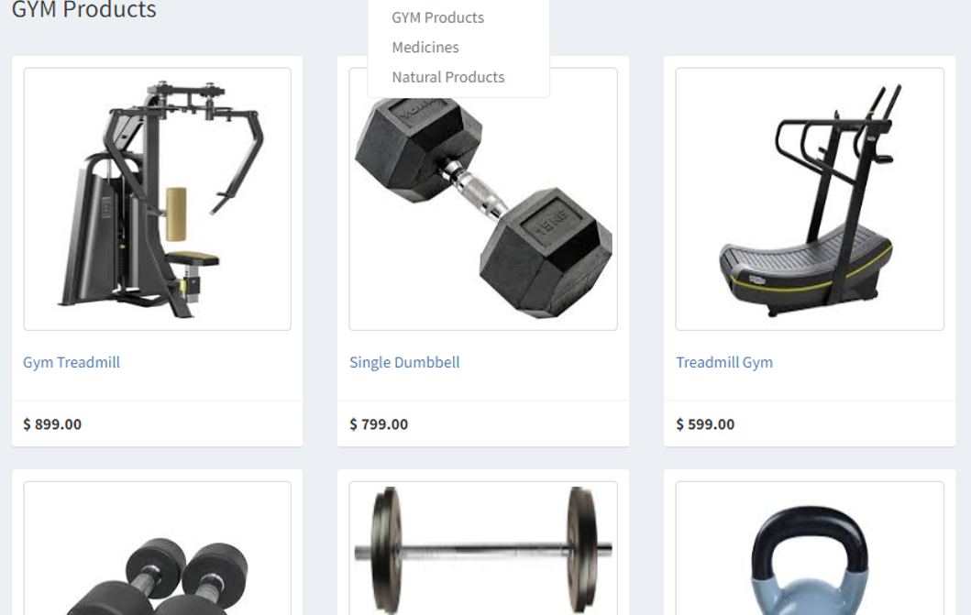
User module
Customers come to the website or online marketplace and purchase products using electronic payments. Upon receiving the money, the merchant ships the goods or provides the service.
Users can purchase items, arrange for delivery and payments on the same site

Slide 7
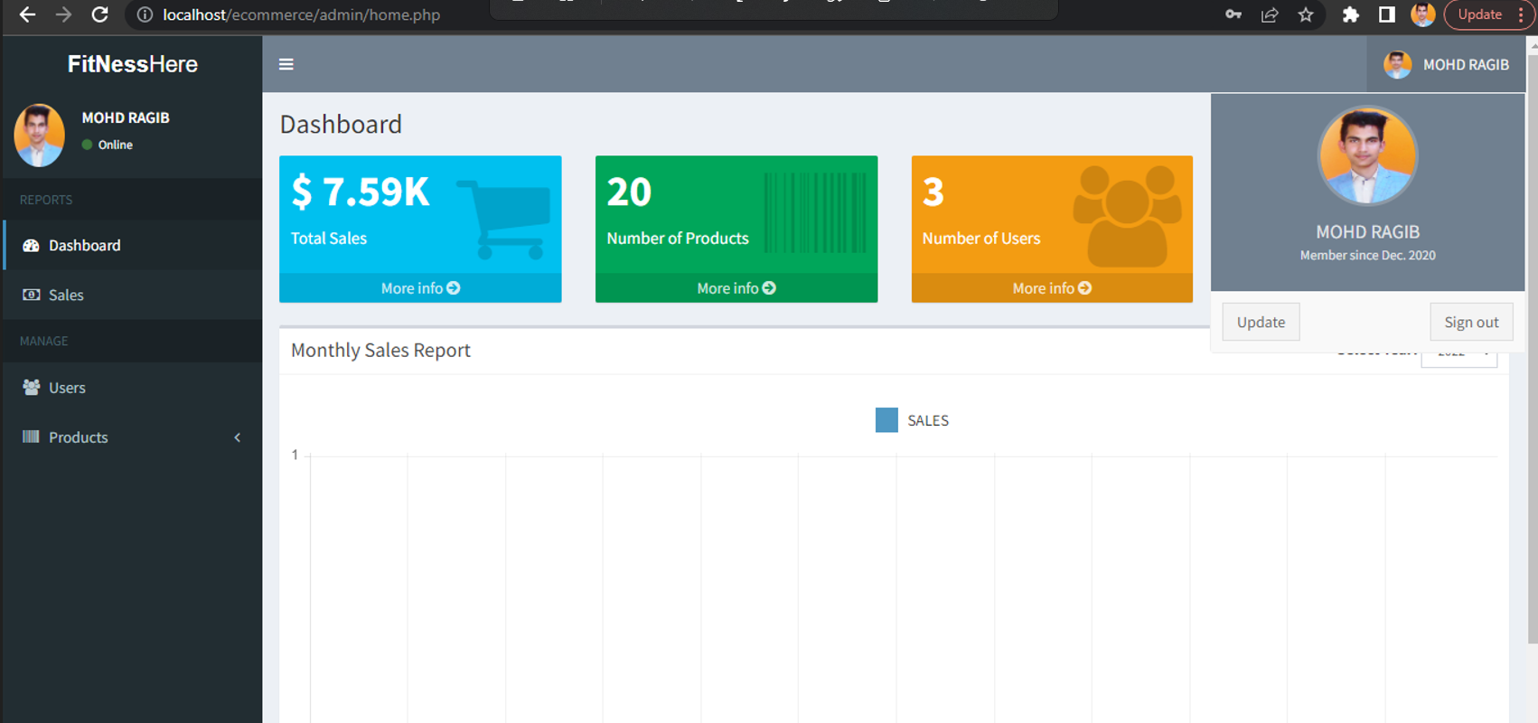
FITNESS HERE Admin Panel

Slide 8
Admin Panel
An administrator easily manage products, categories, orders and shipping. The tasks related to upload of images and videos for your website are done by an administrator. For ensuring timely delivery to your customers, coordination with key info of owners is maintained by an administrator.

Slide 9
System Module
Registration In order to use the system the users will need to register in the system, and for registration, they need to provide various information related to them such as name, address, etc. Search bar This provides users with an option through which they can search the product they want to purchase. Cart After selecting a product if the user wants to purchase it, later they can save the product in the cart. Check out Through this module, the user can place their order and can choose preferred method for payment. Purchase history This will show the purchase done by the user in the past.

Slide 10

EXISTING SYSTEM

Slide 11
EXISTING SYSTEM
The E-commerce Management System has various flaws in it as because of which most of the people don’t use the system even though it has several advantages over traditional stores. The biggest problem is that it takes at least a day to deliver a product to the customer. While some other issues are a duplication of the product means the product is shown on the web some time differs with the original product due to which next time that customer go to buy the product through the traditional type of store.

Slide 12
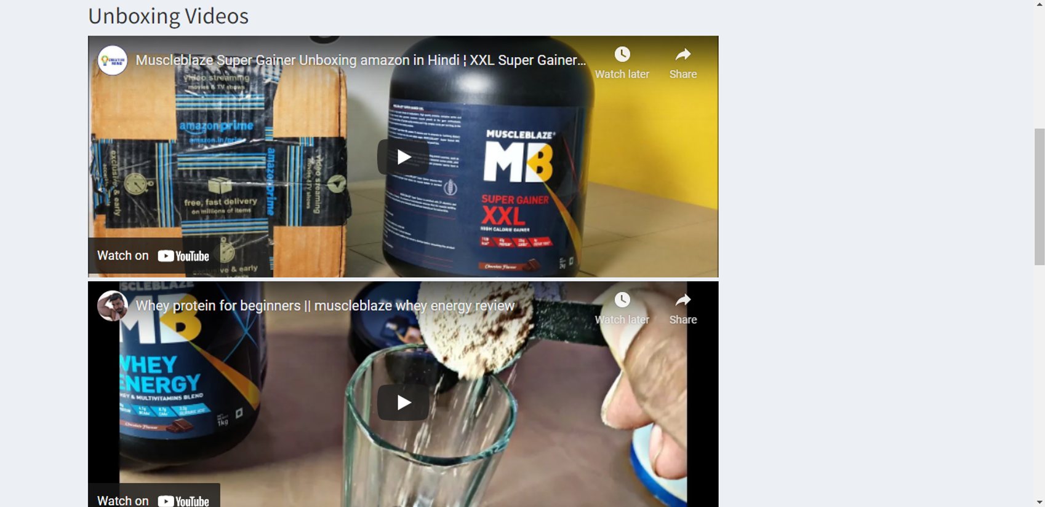
PROPOSED SYSTEM

Slide 13
PROPOSED SYSTEM
The E-commerce Management System has many advantages, compare to traditional store as one can compare the cost of a product with other e-commerce websites, and if a user dislikes any product he/she can return it. While we can make use of the current technology to overcome the problem with the existing system. The E-commerce Management System companies can use a flying robot, so when a user places an order, the company will send the product through the robot. The robot will find the user by using the GPS, and in this way, we can reduce the time to deliver a product. While before sending a product the e-commerce company will check the product that it is same or not with the requested order.

Slide 14
Advantages Of This Project
1. Faster buying process 2. Store and product listing creation 3. Cost reduction 4. Affordable advertising and marketing 5. Flexibility for customers 6. No reach limitations 7. Product and price comparison 8. Faster response to buyer/market demands 9. Several payment modes

Slide 15
ABOUT TEAM
TEAM LEADER- MOHD RAGIB
TEAM MEMBERS-
1.SHIV DIXIT
2.SANIDHYA CHOUDHARY

Slide 16
TECHNOLOGY USED
Website – Dynamic website
Database – MySQL
Languages :-
Front End - HTML, BOOTSTRAP, JQUERY, JAVASQRIPT,CSS
Back End - PHP, MySQL
Project Name - FITNESS HERE (E-Commerce)
Language Used - PHP
User Interface Design - HTML ,CSS bootstrap, AJAX,JQUERY,JAVASCRIPT
Web Browser Mozilla, Google Chrome, IE8, OPERA
Software XAMPP / Wamp / Mamp/ Lamp (anyone)

Slide 17
HARDWARE REQUIREMENT
256 MB Ram
512 KB Cache Memory
Hard disk 10 GB
Internet connection

Slide 18
SOFTWARE REQUIREMENT
Windows XP and above
PHP
• APACHE
• SQL Server 2005
• HTML/CSS

Slide 19
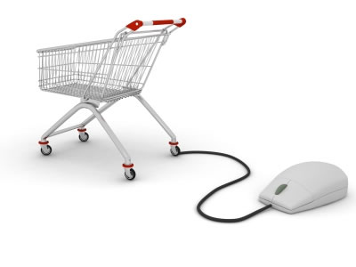
CONCLUSION
After careful observation, it has come to my conclusion that e-commerce has undeniably become an important part of our society. The world wide web is and will have a large part in our daily lives. It is therefore critical that small businesses have their own to keep in competition with other companies

Slide 20

THANK YOU

